Slide 1

Speech Patterns of Democratic Presidential Candidates
Ben Gruher, Yu Fu, Matthew Echert

Slide 2
Motivation and Audience
Motivation
Explore how candidates’ speech patterns vary from topic to topic
Identify whether (and which) topics prompt candidates to speak more quickly/loudly
Illuminate candidates’ relative strengths/weaknesses and values

Slide 3
Motivation and Audience
Audience
Political scientists
Voters
Campaign strategists
Journalists
...anybody interested in U.S. politics

Slide 4
Tools and Data
D3.js, Observable
HTML/CSS
Numpy, Pandas, Matplotlib, Seaborn
Adobe Audition
pydub

Slide 5
Tools and Data
Audio files of Bernie Sanders and Elizabeth Warren’s responses during the New Hampshire debates
Data files as CSV with volume, WPM, transcript for displaying, color for plot

Slide 6
Related Work
Beyond Speaking Time: An Analysis of Democratic Presidential Debates, by Jenny Lee
https://towardsdatascience.com/which-presidential-candidate-talks-like-that-b2b16060ff8b
Notes:
First graph indicates the average length of each candidate’s responses. The graphs on the right measure the linguistic complexity of the candidates’ speech—how many complex clauses they used and how many words they spoke before the main verb of each sentence.

Slide 7
Related Work
Democratic Presidential Debate Analysis Using the Wolfram Language, by Brian Wood
https://blog.wolfram.com/2020/02/06/democratic-presidential-debate-analysis-using-the-wolfram-language/
Notes:
Graph shows number of words spoken per candidate, total.

Slide 8
Related Work
Visualizing the speeches given by world leaders at UNGA, by Some Aditya Mandal
https://towardsdatascience.com/visualizing-the-speeches-of-world-leaders-at-unga-d7319e00e180
Notes:
Graph analyzes the speech of Emmanuel Macron to the UN General Assembly last year, (similar graphs for other leaders.) The bar chart breaks out the most salient terms in the speech

Slide 9
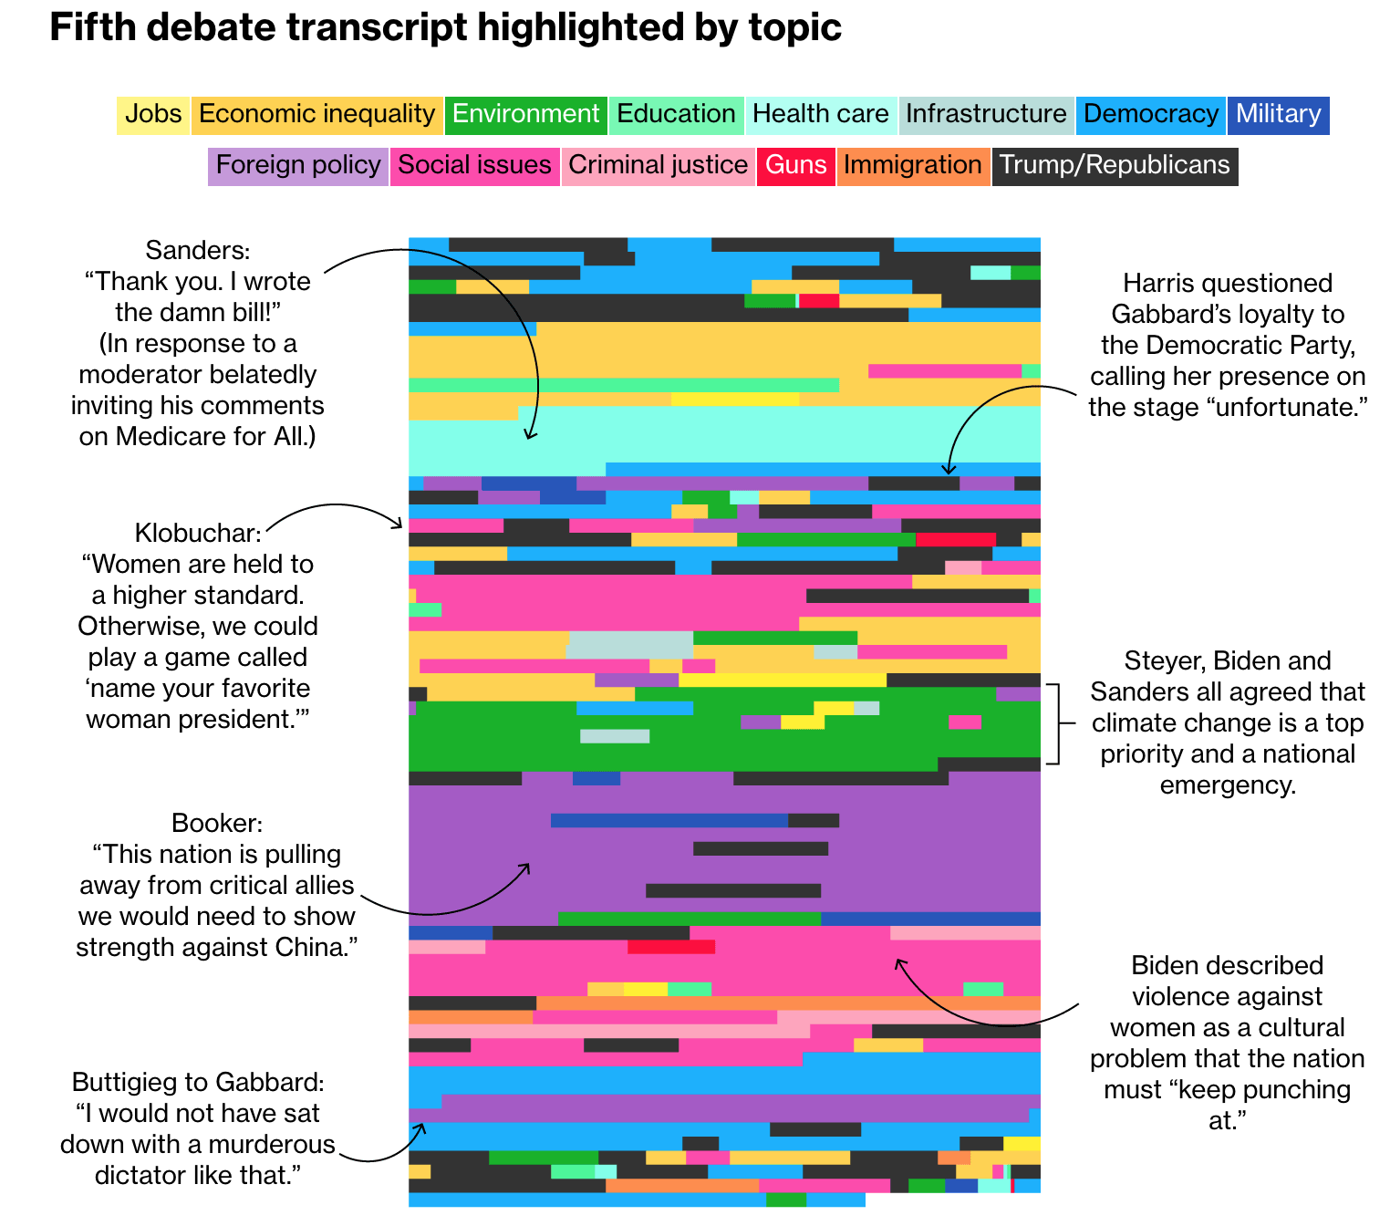
Related Work
Everything the Candidates Discussed at the Atlanta Debate, by Allison McCartney et al.
https://www.bloomberg.com/graphics/democratic-presidential-debate-atlanta-recap/
Notes:
This visualization is one of several made for Bloomberg News to encode the various topics discussed during the Atlanta debate in November.

Slide 10
Demo

Slide 11
Design Rationale
Time encoded on X-axis
Volume of speech relative to baseline as bar height
Topic represented by color of bar
Speed (WPM) encoded by saturation of bar color

Slide 12
Insights
In general, Warren speaks faster and for longer than Sanders
Sanders’ speech is at its most intense in the middle of the debate when speaking about the 2020 campaign, speaking more slowly on other topics
Sanders and Warren both talked about their campaigns extensively, but Warren included more about the economy and social justice

Slide 13
Q&A

